Slide 1

NALLA MALLA REDDY ENGINEERING COLLEGE
Autonomous Institution
Department of Computer Science & Engineering
2022-23
Major Project on
MediFit
Guide Details:
Mr. S. Ramchandra Reddy
Assistant Professor
Department of CSE
Team Members:
V. Sai Mukesh Reddy – 19B61A05F9
O. Srivalli Hrushitha – 19B61A05B3
K. Sai Narsimha Reddy – 19B61A0572
T. Venkata Giridhar – 19B61A05F4
Batch No. 4C3

Slide 2
Implementation Review Seminar

Slide 3
Introduction
People today deal with a variety of diseases as a result of their lifestyle and the surroundings. As a result, it is crucial to predict diseases early on.
The hardest task is making an accurate diagnosis of a condition.
Our project aim is to predict diabetes and heart disease by utilizing machine learning algorithms.
Additionally, our system also provides personalized recommendations for nutrition and yoga poses to help manage the detected disease.

Slide 4
Problem Statement
There is a growing burden of lifestyle-related diseases such as diabetes and heart disease, which can often be prevented or managed through lifestyle interventions such as diet and exercise.
However, many people struggle to adopt and maintain healthy habits due to factors such as lack of knowledge, motivation, and social support.
The drawbacks of the existing system include cost, limited accessibility and lack of tailored recommendations.

Slide 5
Proposed System
Our proposed system is a machine learning-based platform that aims to predict the risk of developing diabetes and heart disease based on various input parameters.
The system also provides personalized recommendations for nutrition and yoga therapy based on the detected disease.
For example, the system might recommend specific foods or dietary interventions to help manage blood sugar levels for diabetes, or suggest yoga poses that are beneficial for reducing stress and improving cardiovascular health for heart disease.

Slide 6
Details of Modules
User Interface: The User Interface (UI) is a critical aspect of our project as it is the primary way for users to interact with the system. In the context of our project, a well-designed UI can help users easily input their medical parameters and receive disease predictions, food recommendations, and yoga tips.
PoseNet: We are using PoseNet to derive the parameters by tracking human pose. By using PoseNet, we can accurately detect yoga poses in real-time and provide feedback to the user based on their form and positioning.
Prediction: Prediction of heart and diabetes disease using input parameters given by the user

Slide 7
Functionalities of the Project
User Registration: The user should be able to register and login. The user can enter their personal details like age, weight etc during the registration process.
Disease Classification: The user should be able to get accurate results based on the parameters entered.
Pose Tracking: From the visuals, the system should be able to identify if the user is maintaining the correct posture or not.
Diet Recommendation: Based on the personal parameters shared by the user, the system should suggest the kind of food/ quantity that needs to be consumed.

Slide 8
Application of the Project
Healthcare industry: Our project can be used in the healthcare industry to provide personalized healthcare solutions for patients suffering from diabetes and heart disease. It can also be used by healthcare professionals to monitor the progress of their patients.
Fitness industry: Our project can be used in the fitness industry to provide personalized fitness solutions for individuals. It can be used to create customized workout plans and yoga routines for people based on their health conditions.
Personal healthcare: Our project can be used by individuals to monitor their own health and fitness levels. They can use it to track their progress, set goals and get personalized recommendations for diet and exercise.

Slide 9
Hardware Requirements
Processor : Intel i3 or higher
RAM: 4GB or higher
Camera: Minimum 2MP
Software Requirements
Windows 8 or later.
Python programing language and all related packages.
VS Code

Slide 10
Testing and Implementation
Unit Testing: This involves testing individual components or modules of the system like classification of disease to ensure that each one works as intended.
Integration Testing: This involves testing how different modules or components of the system work together when integrated to ensure they function correctly as a whole. We tested whether the system is able to use the parameters provided by the user to give suggestions.
Usability Testing: This involves testing the system's user interface and user experience to ensure it is intuitive and easy to use for the target audience.
Acceptance Testing: This involves testing the system with a focus on meeting user requirements and expectations to ensure the system is ready for deployment.

Slide 11
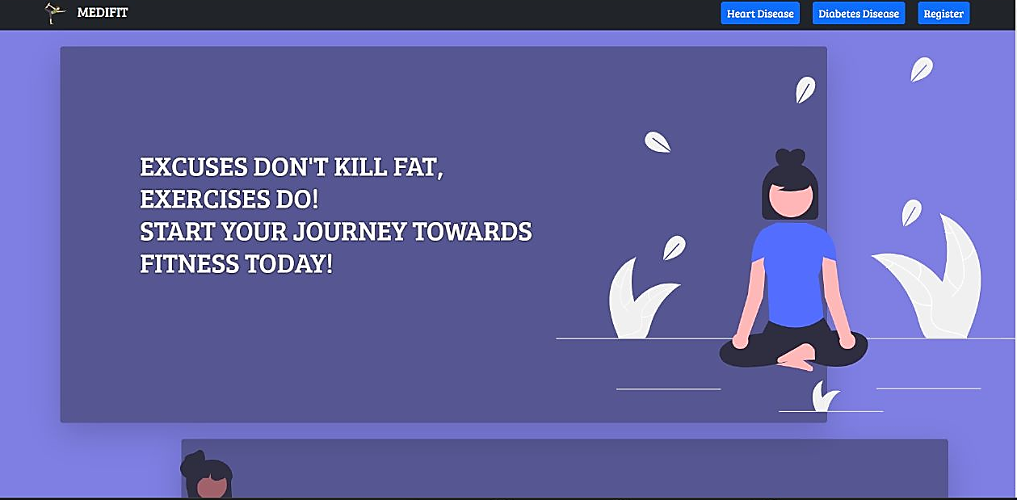
Screen Shot of the Login/Home Page

Slide 12
Conclusion
In conclusion, our project MediFit is a solution to predict and prevent diseases like diabetes and heart disease while providing customized yoga poses and food suggestions to users. It has been designed and implemented with a user-friendly interface, ensuring easy navigation and interaction with the application.
Our project comprises different modules, each with its unique functionality, including disease prediction, food recommendation, yoga pose detection, and user management. These modules work together to provide a comprehensive solution to our users.
MediFit has various real-life applications, including healthcare, fitness centers, and personal use. Our application can help individuals in maintaining a healthy lifestyle and reducing the risk of chronic diseases.

Slide 13
Thank You

